Slide 1
Kapittel 5 Transport

Slide 2
Figur 5.1 Modell for transportvalg

Slide 3
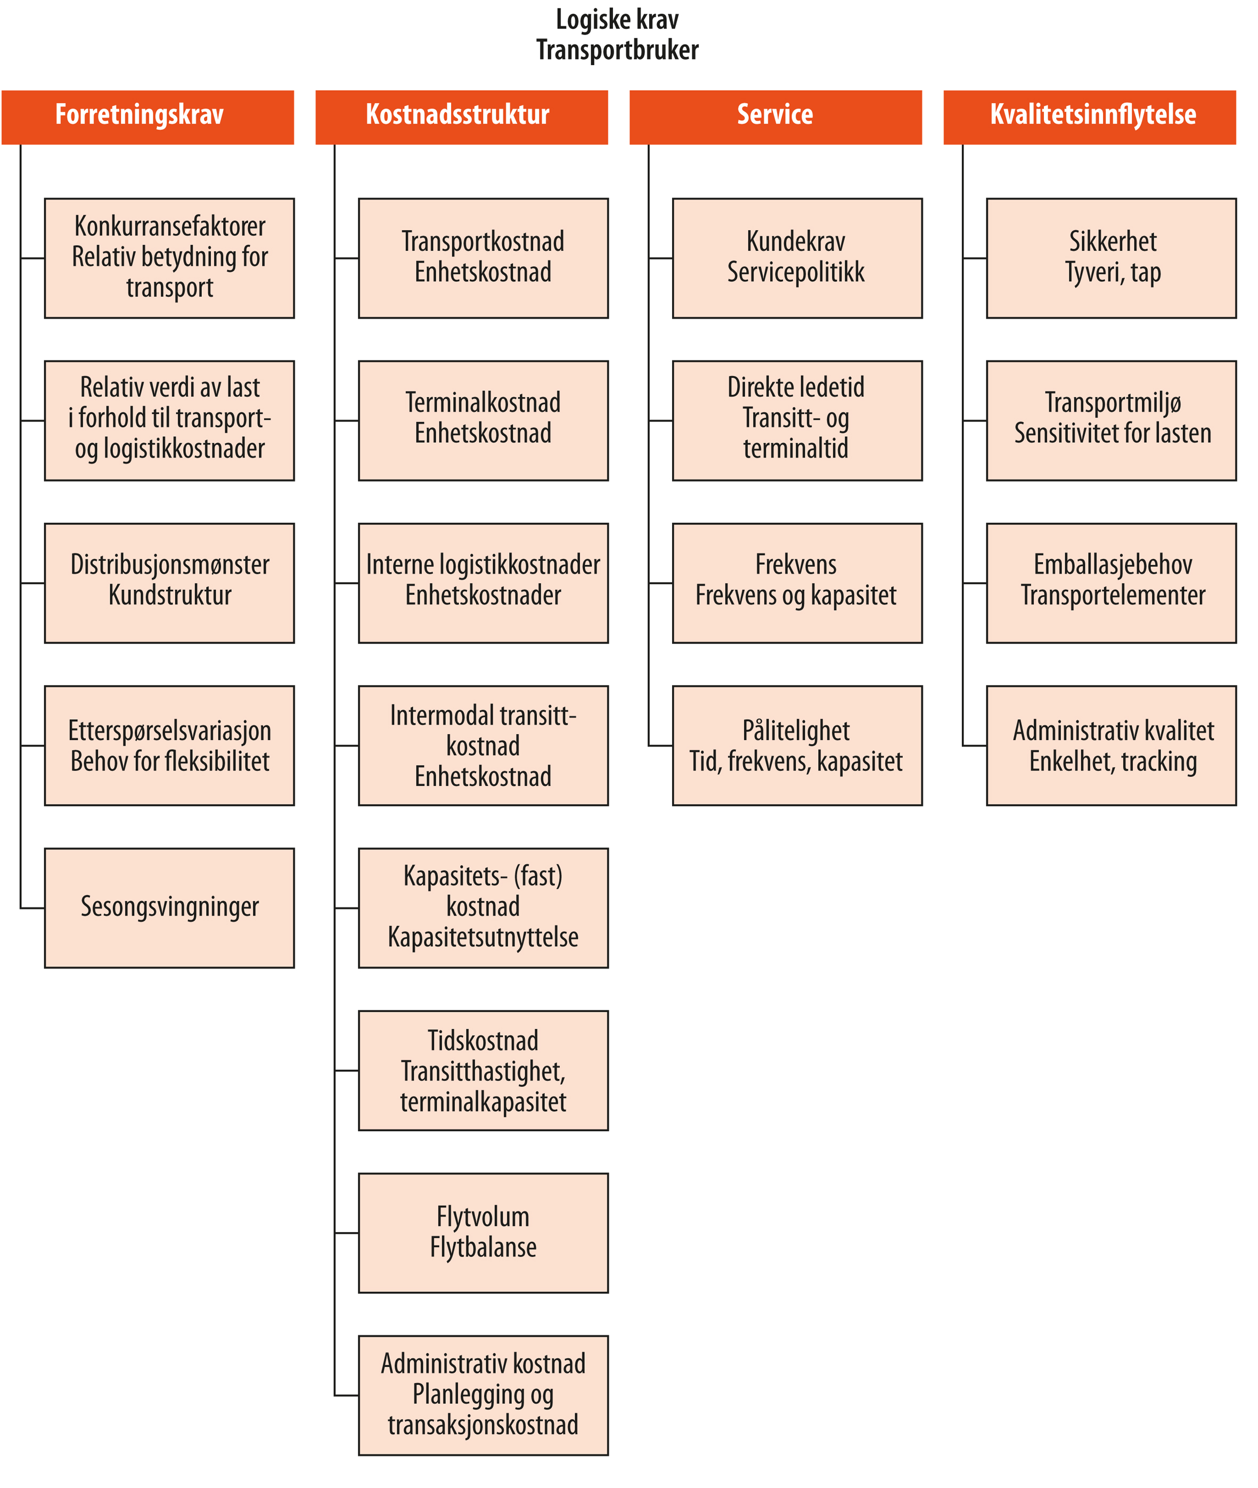
Figur 5.2 Modell for transportvalg

